Slide 1
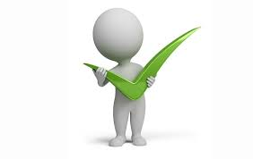
Positive Personality Traits
Vocabulary Unit

Slide 2
Does anything look familiar?
Cerebral
Pious
Congenial
Astute
Photogenic
Gregarious
Tenacious
Amenable
Docile
Erudite

Slide 3
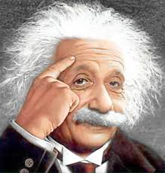
Cerebral (suh REE brul)
Definition: adj./ noun- of or relating to the brain; an intellectual person
Synonyms: smart, intelligent, brainy
Link: Cereal
Eat your healthy cereal so you’ll grow up to be cerebral.
Albert Einstein was extremely cerebral. He developed the theory of relativity and the formula E=MC2.

Slide 4
Pious (PI us)
Definition: adj.- devout or virtuous; holy
Synonyms: holy, religious, saintly
Link: Pie
Elizabeth piously prayed for pie every night before she went to bed.
The opposite of pious is impious, which is to lack respect or be unholy.

Slide 5
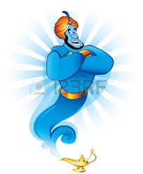
Congenial (kun JEAN ee ul)
Definition: adj.- pleasant to be around; social
Synonyms: friendly, likeable
Link: Genie
Everyone agreed that the genie was congenial. He was friendly with everyone and also granted their wishes.
The atmosphere at the dentist office is very congenial. Everyone enjoys their job and visitors are always treated nicely.

Slide 6
Astute (uh STOOT)
Definition: adj.- having the ability to judge situations/ people and use it to one’s advantage.
Synonyms: bright, quick, clever, observant
Link: Suit
Larry hoped that his new suit would make him appear to be more astute for his job interview.
The astute car salesman noticed that his customer loved the Dallas Cowboys, so he talked football and made a sale.
An astute observation is when someone notices something no one else has noticed or something which solves a problem.

Slide 7
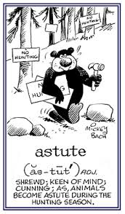
Astute (uh STOOT)

Slide 8
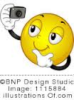
Photogenic (phoh toe GIN ik)
Definition: adj.- especially attractive for photography.
Synonyms: attractive, good looking, beautiful/handsome
Link: Photo genie
The genie was so photogenic that she became a supermodel.
People love to put their best selfies on Instagram in order to show off how photogenic they are.
Most people are not photogenic in the morning.

Slide 9
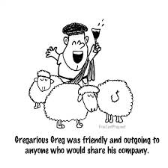
Gregarious (gruh GAIR ee us)
Definition: adj.- seeking and enjoying the company of others.
Synonyms: social, people person
Link: Greg hilarious
Gregarious Greg was so hilarious that everyone loved him.
Carol was not a gregarious person. She rarely talked to people and did not like to be social.

Slide 10
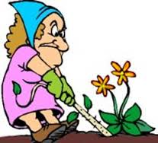
Tenacious (teh NAY shus)
Definition: adj.- tough, stubborn, not letting go.
Synonyms: stubborn, persistent
Link: Tennis Aces
To make an ace in tennis, you have to be tenacious at practice.
The weeds in the yard are so tenacious that we can never get rid of them.
Julie had a tenacious attitude. After she failed her test, she studied even harder until she finally passed it.

Slide 11
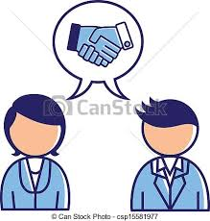
Amenable (ah MEE nuh bul)
Definition: adj.- agreeable, responsible to authority, willing to give in to the wishes of another.
Synonyms: pleasant, easy to get along with, cooperative
Link: Mean bull
The matador could not get the mean bull to be amenable.
Joey’s mom was not amenable with his father, so they got a divorce since she would not make compromises.
Though Jack doesn’t like bell pepper, he was amenable when his brother asked him to put it on the pizza.

Slide 12
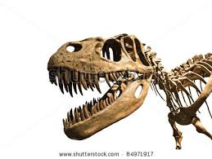
Docile (DAHS ul)
Definition: adj.- easily taught or controlled; easy to handle.
Synonyms: obedient, submissive, gentle
Link: Fossil
A live dinosaur is aggressive while a dinosaur fossil is docile because it cannot bite or injure anything.
Many people fear pit bulls, but their supporters say that they are actually quite docile.
The football player was fierce on the field, but his family said he was a sweet, docile man at home.

Slide 13
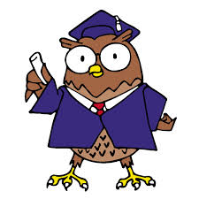
Erudite (ER yoo dyte)
Definition: adj.- deeply learned, scholarly.
Synonyms: educated, well read
Link: Air tight
Because he was erudite, the lawyer’s case was airtight and he won.
Most professors are very erudite, with the understanding of proper grammar, having a large vocabulary, and great amount of knowledge.

Slide 14
Creating Sentences
Choose five of the words you have been given and compose sentences using them.
Use these contexts:
1. A party
2. A dance
3. A doctor’s office
4. Passing a test
5. A college professor

Slide 15
Monsters!
Using five of your vocabulary words, quickly compose a short story about a monster. Describe what it looks like, where it comes from, and things it does.

